Slide 1
Machine Learning Regression
Boosting Algorithm

Slide 2

Boosting Algorithm
Ada Boost
XG Boosting
LG Boosting

Slide 3
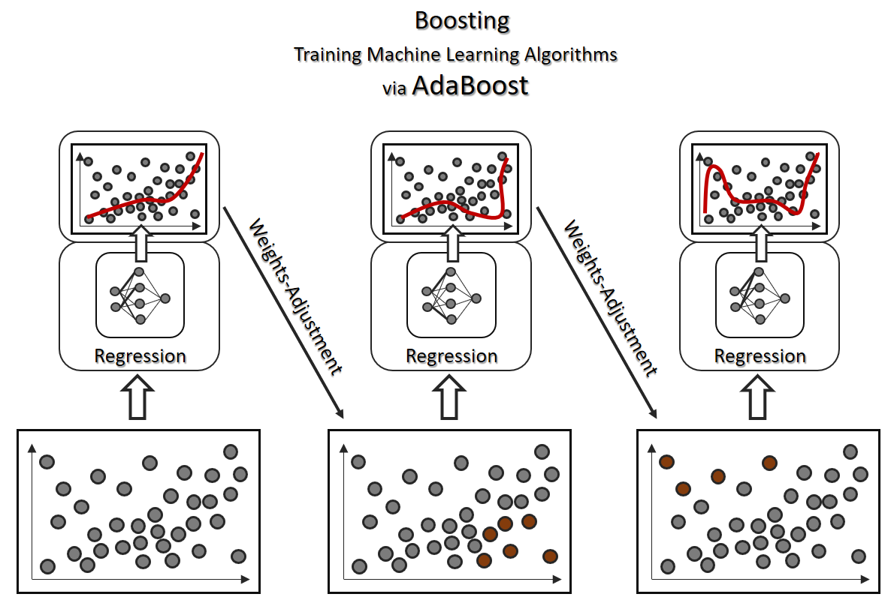
Ada Boost
AdaBoost regressor is a meta-estimator that begins by fitting a regressor on the original dataset and then fits additional copies of the regressor on the same dataset but where the weights of instances are adjusted according to the error of the current prediction.

Slide 4
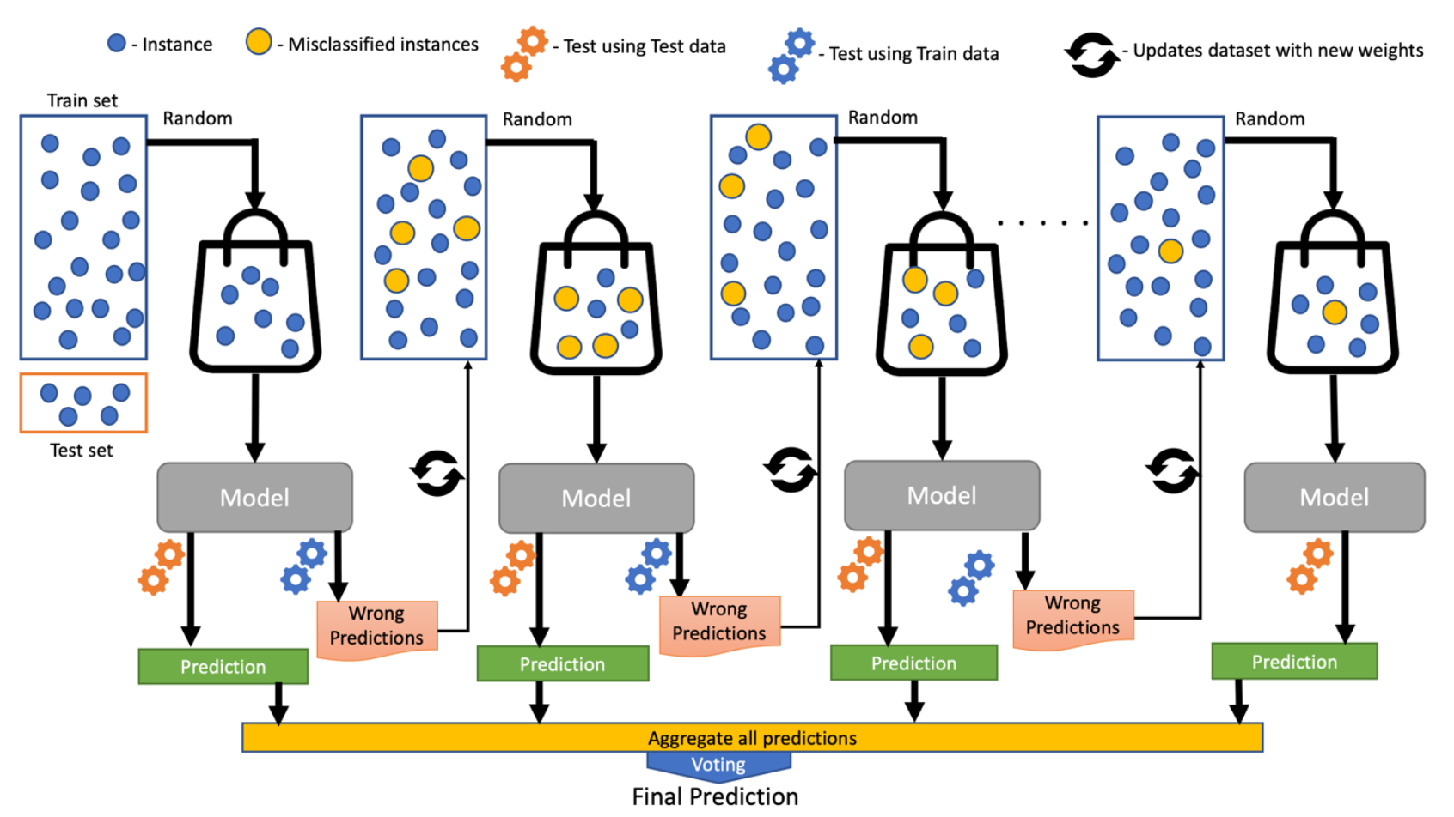
XG Boosting (or) Gradient Boosting
XGBoost is an optimized distributed gradient boosting library designed for efficient and scalable training of machine learning models. It is an ensemble learning method that combines the predictions of multiple weak models to produce a stronger prediction. XGBoost stands for “Extreme Gradient Boosting”

Slide 5
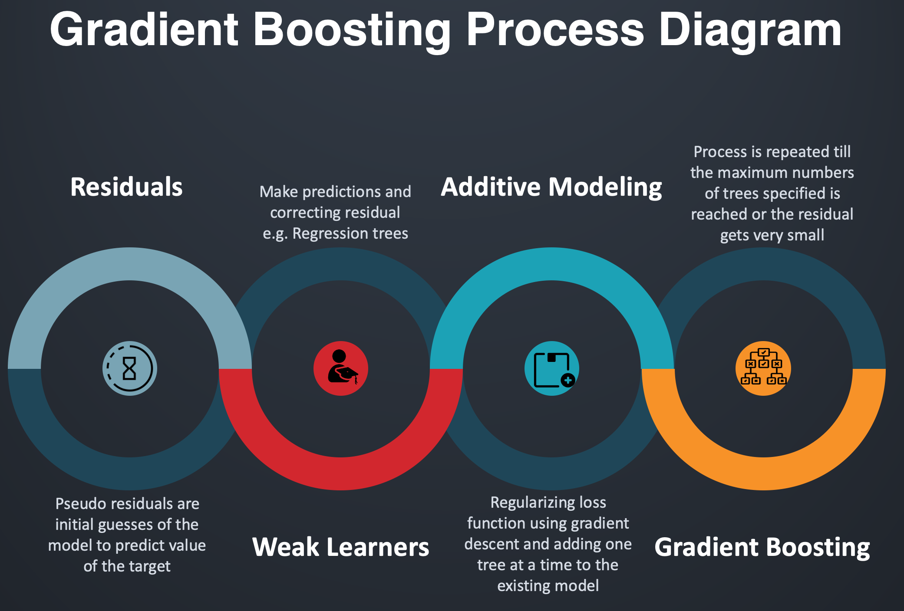
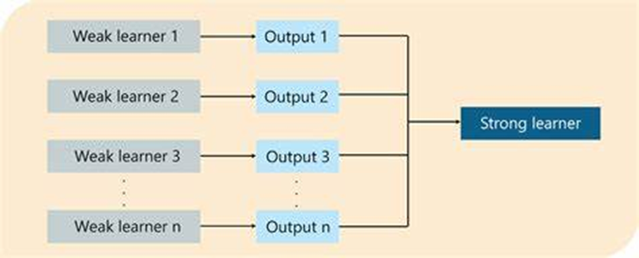
XG Boosting (or) Gradient Boosting

Slide 6
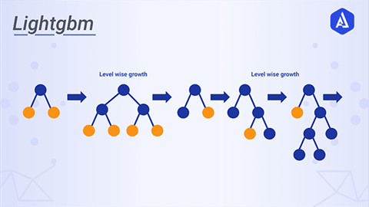
LG Boosting (Light Gradient Boosting)
LightGBM is a gradient boosting framework based on decision trees to increases the efficiency of the model and reduces memory usage.
It uses two novel techniques:
Gradient-based One Side Sampling and Exclusive Feature Bundling (EFB)

Slide 7
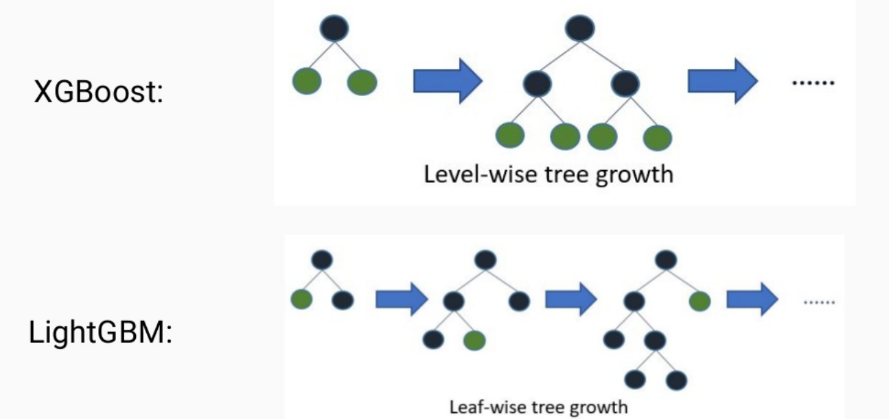
XG Boosting Vs LG Boosting

Slide 8
Thank You

